Slide 1
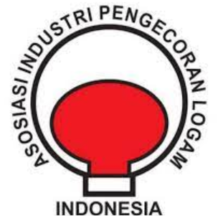
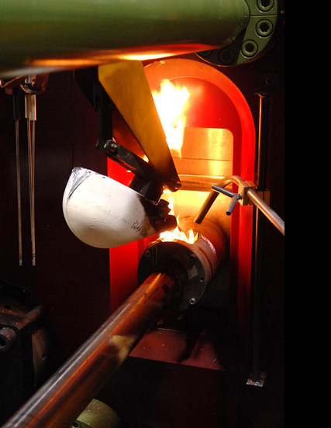
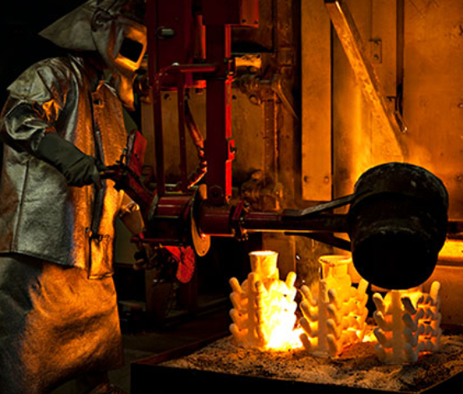
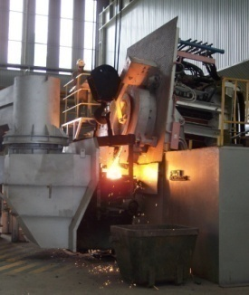
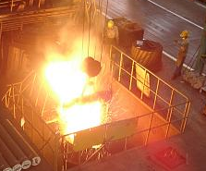
APLINDO
Indonesian Foundry Industries Association
(Asosiasi Industri Pengecoran Logam Indonesia)
New way of Thinking
for Sustainability
oleh :
Erwan Yulianto
Chairman APLINDO
Jakarta, July 13th 2023

Slide 2
1. APLINDO
APLINDO is the Indonesian Foundry Industry Association, which was established on December 9, 1981, with 52 industry members, most of whom are spread across the islands of Java and Sumatra.
Detail of member
Detail | No of industry | No of Employee
Ferrous |  | 25.522 orang
Ductile Casting/Grey Casting/Steel Casting/Malleable Casting | 23
Investment Casting | 6
Non Ferrous
Alumunium casting (Die casting & Sand Casting) | 10
Smelter Alumunium (Ingot Al) | 3
Smelter Lead (lead Pb) | 3
Supplier
Supplier Material & Equipment | 8
Total | 52
Remark | Installed Cap. (Ton/year)
Ferro Casting (Ductile, grey, maleable, steel, Stainless Steel)
Member | 393.900
Non-member* | 156.100
Total* | 550.000
Non Ferro Casting (Alumunium)
Member | 168.400
Non-member* | 81.600
Total* | 250.000
Alumunium Alloy (Ingot AL)
Member | 298.000
Non-member* | 202.000
Total* | 500.000
Lead Ingot (Pb)
Member | 99.000
Non-member * | 50.000
Total* | 149.000

Slide 3
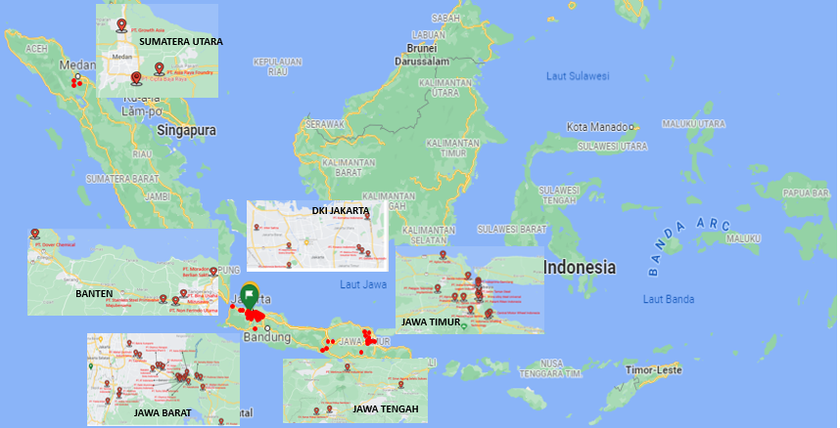
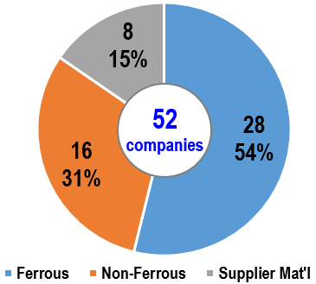
1.1. APLINDO’s Member
North Sumatra area
Jakarta area
Banten area
East Java area
West Java area
Central Java area
The 52 companies registered as members of APLINDO are spread throughout Indonesia, with the majority in the northern part of Sumatra and Java. Data for 2021 show that APLINDO members' total production are 605,000 tons, with 77% domestic market orientation and
23% export orientation.

Slide 4
1.2. APLINDO’s Organization 2021~2026
Supervisory Board :
Ir. Caterin Widjaja ( PT. Growth Asia )
Ir. Awad Umar ( PT. Metinca Prima )
Daily Manager :
Chairman : Erwan Yulianto (PT Komatsu Indonesia)
Vice Chairman: Iwan Lukito ( PT. Trieka Aimex )
Secretary General : Septiyanto Catur Pamungkas (PT Komatsu Indonesia )
Ferro :
Chairman I : Erwin Halim (PT. Inter Satria)
Chairman II : Ir. Widodo (PT. Pakarti Riken Indonesia)
Non Ferro
Chairman I : Catherine Cahyarini G. ( PT. Prolimas Utama Jaya )
Chairman II : Sabah Saparian ( PT. Yamaha Motor Parts Manufacturing)
Advocacy : Rinsan Hutabarat ( PT. Daiki Aluminium Industri )
Treasurer : Iwan Lukito ( PT. Trieka Aimex )

Slide 5
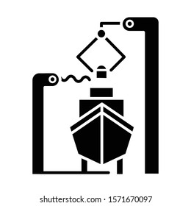

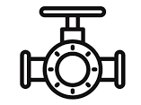





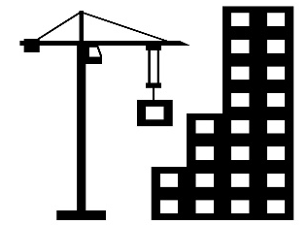



1.3. APLINDO’s Member Casting Application
SHIP BUILDING
POWER GENERATOR
PUMP & VALVES
TRAIN
FERROUS & NON FERROUS
CASTING PARTS
MACHINERIES
HEAVY EQUIPMENT
AUTOMOBILE/ MOTORCYCLE
BUILDING & CONSTRUCTION
INDUSTRIAL CONSUMABLES
ARTS ORNAMENTS
MEDICAL DEVICES

Slide 6
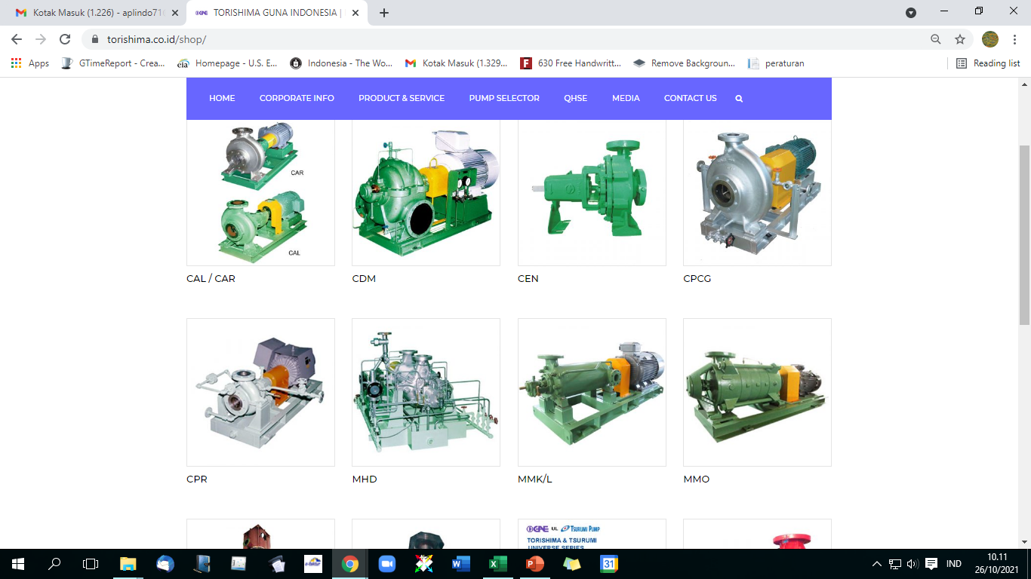
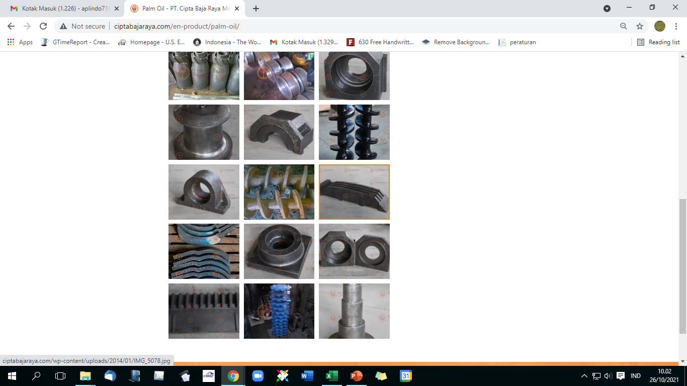
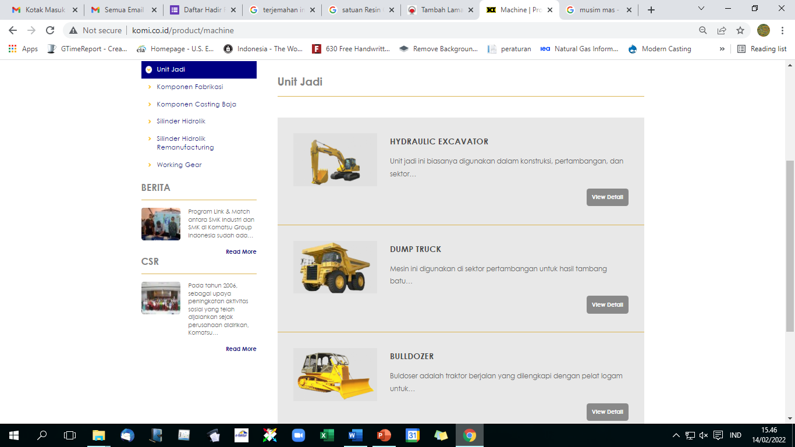
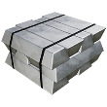
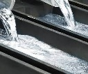
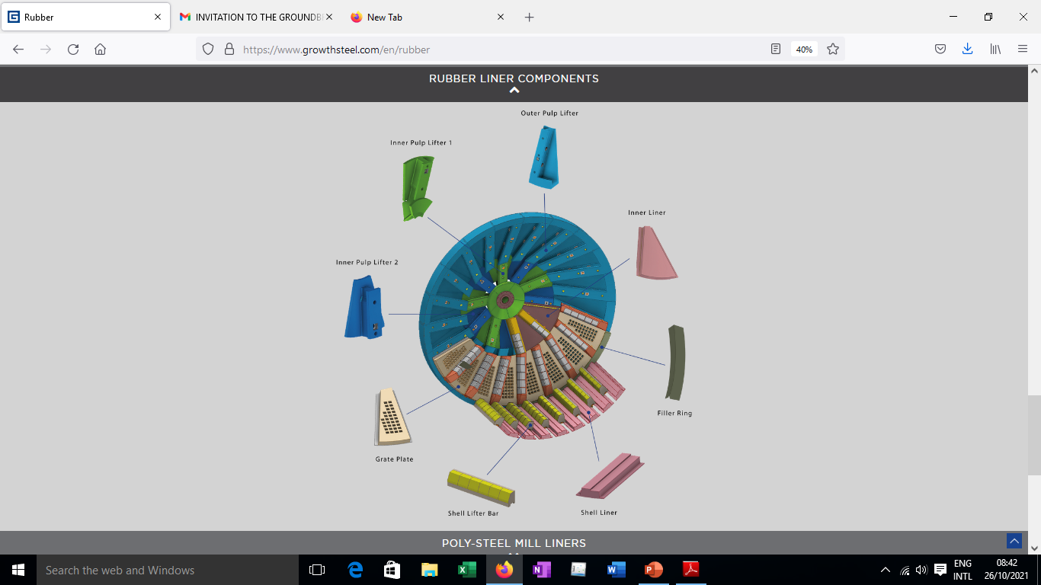
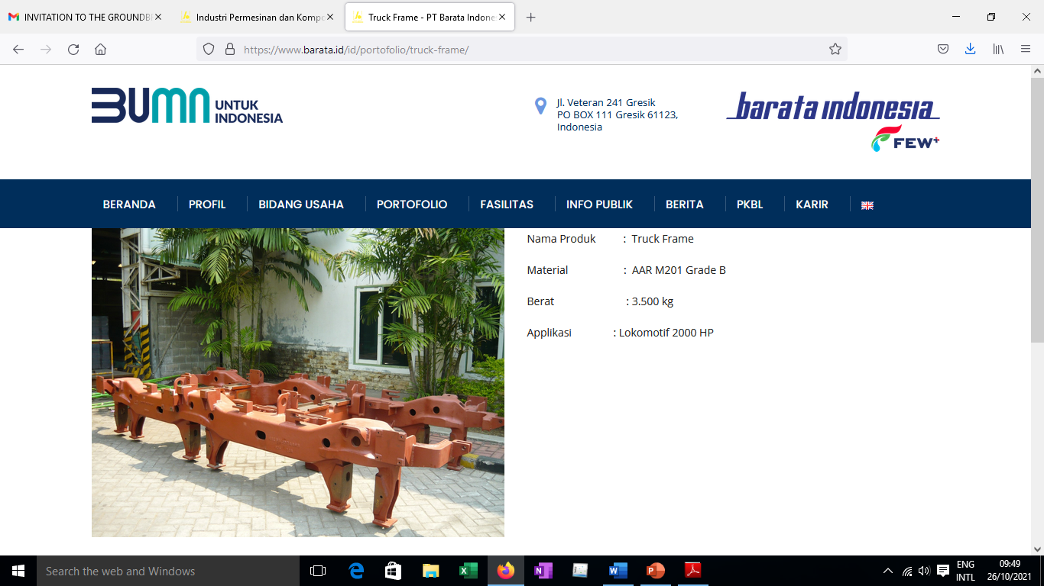
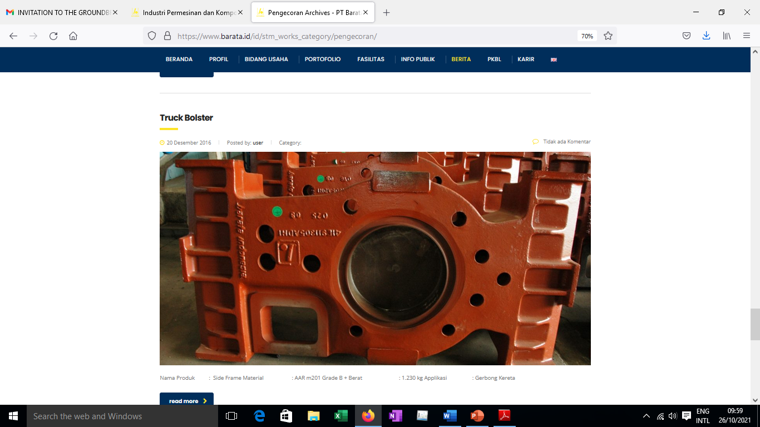
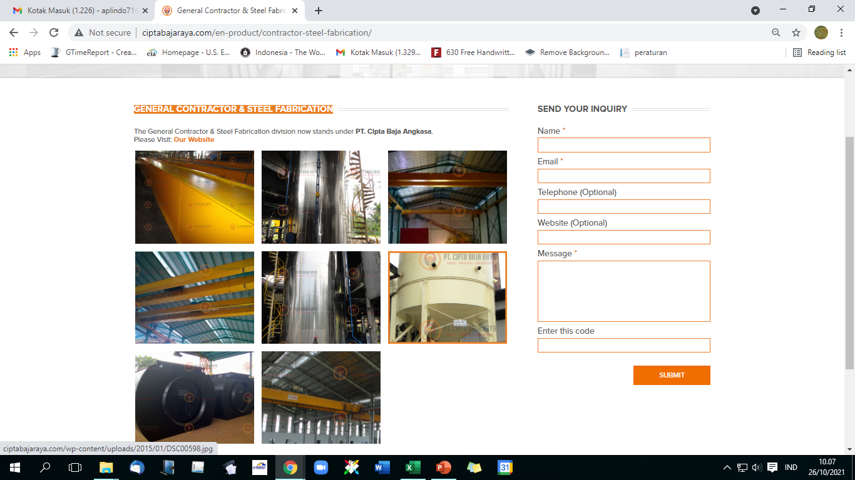
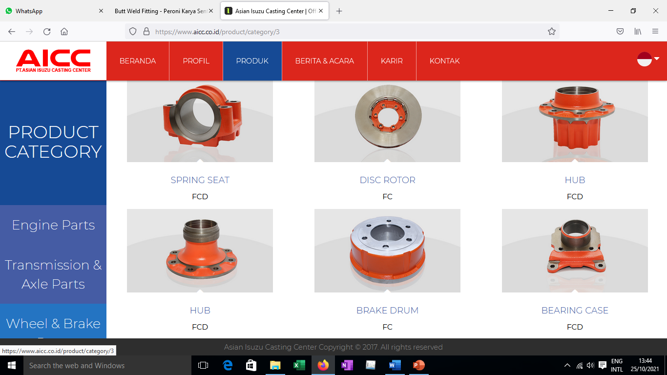
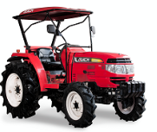
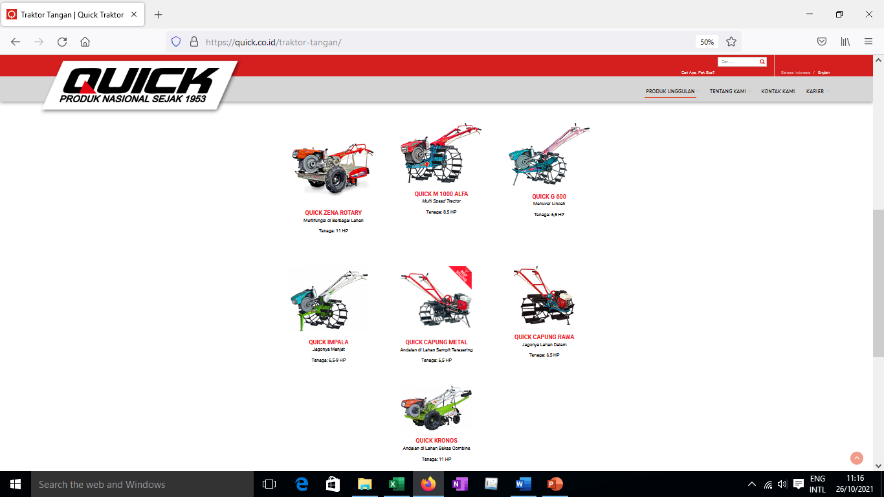

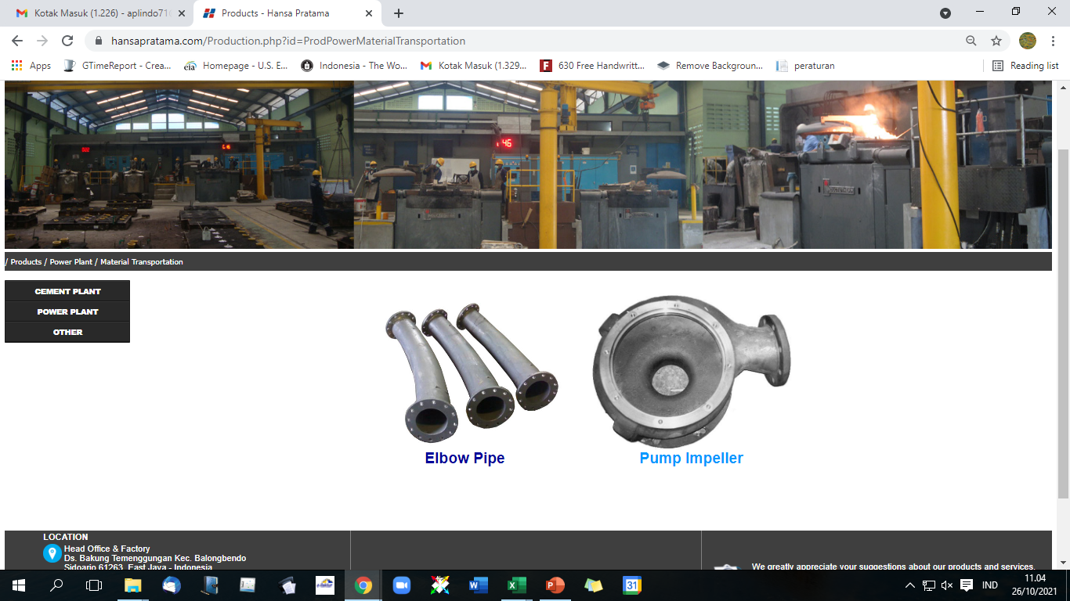


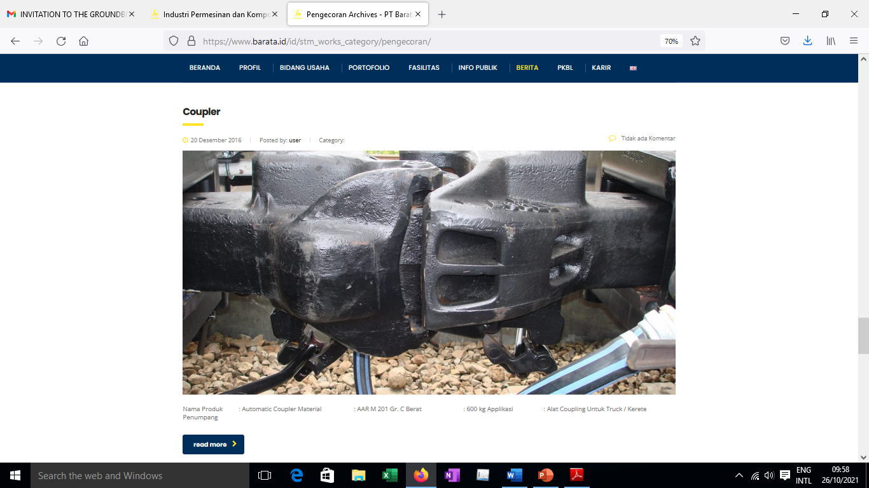
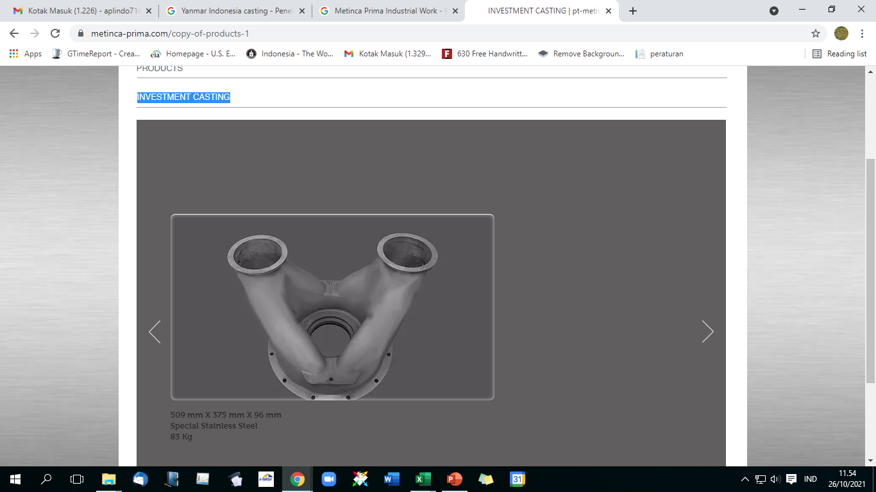
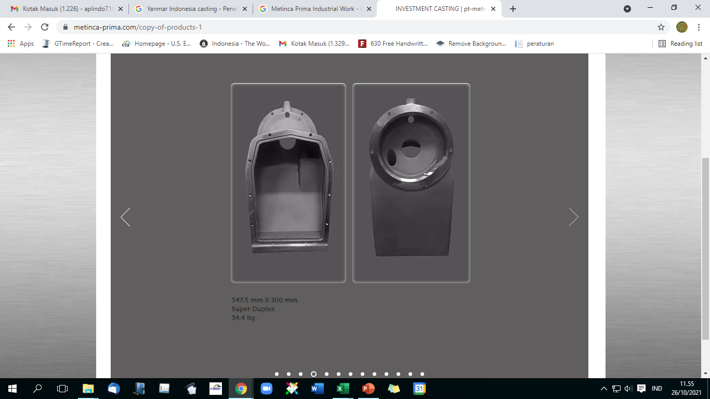
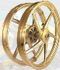



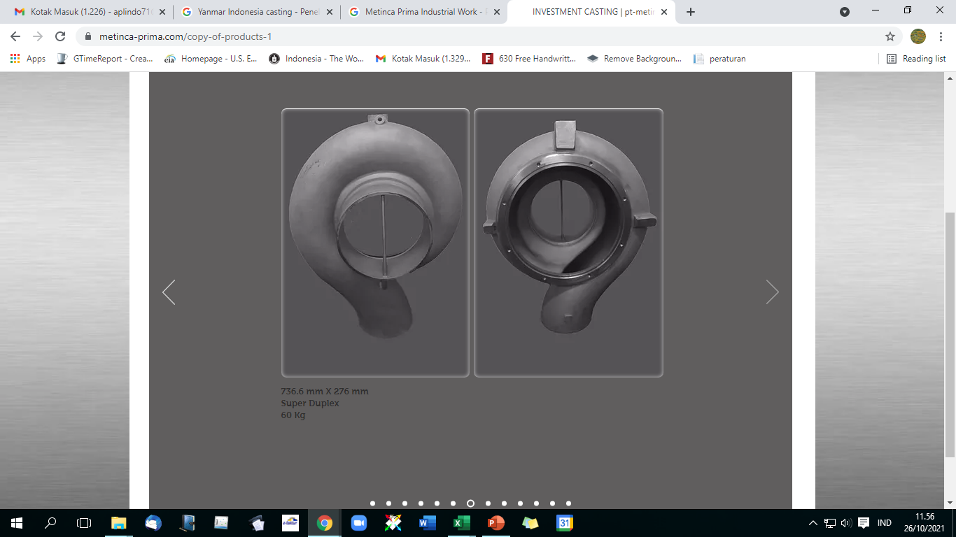
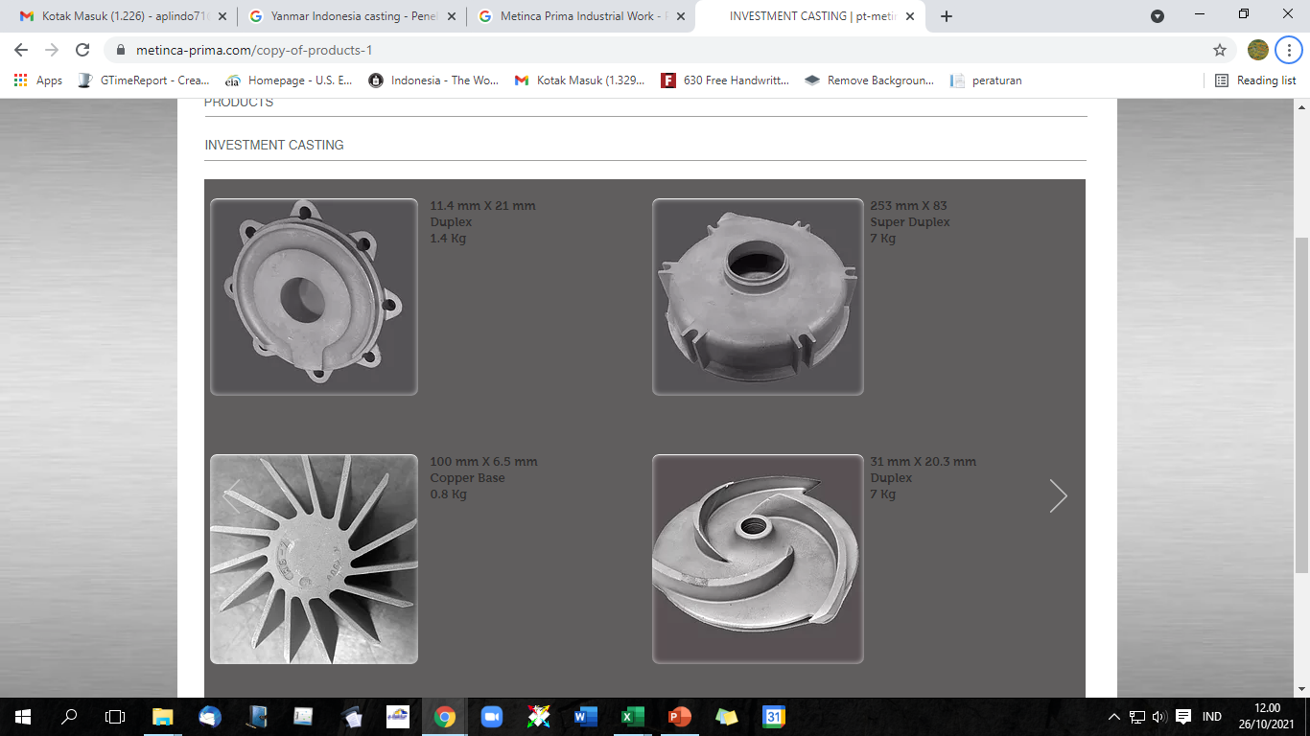
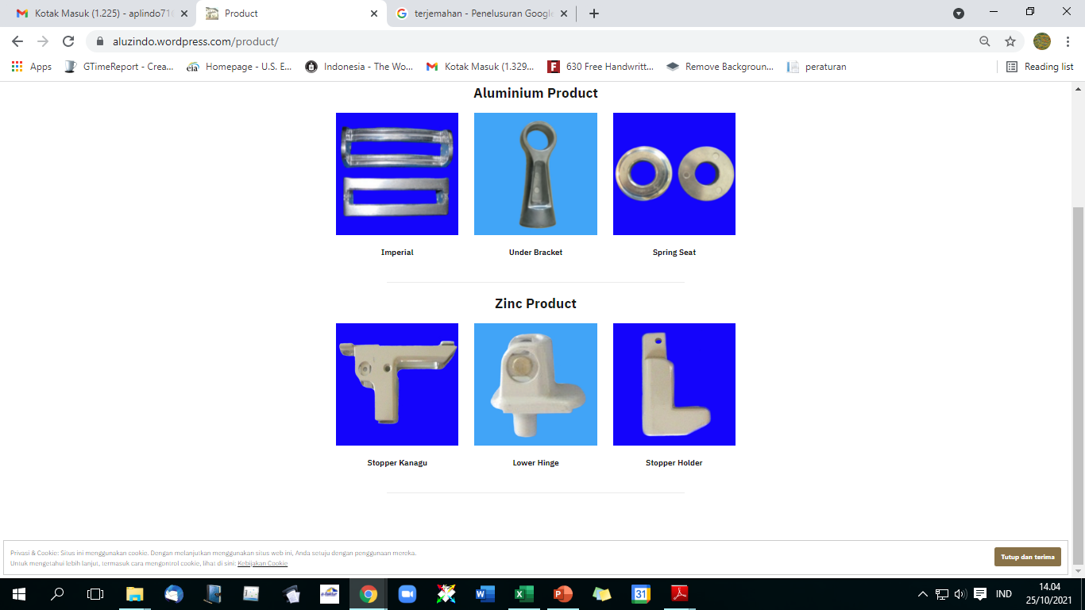
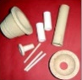
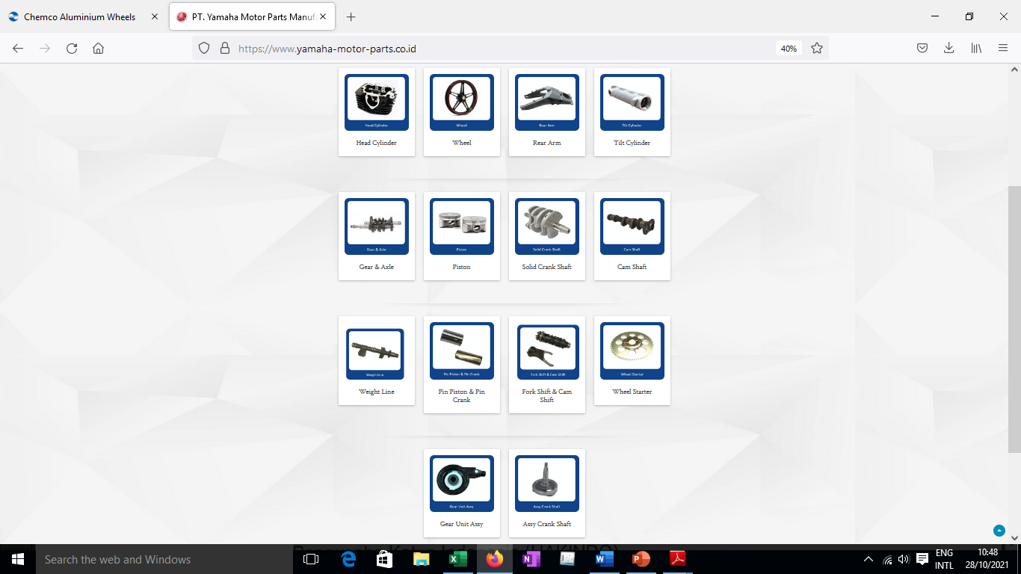
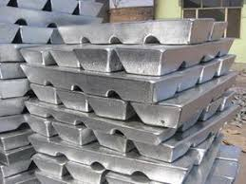
1.3.Member APLINDO
Iron Casting/Ductile
Asian Isuzu Casting Center, PT
AT Indonesia, PT
Aplus Pacific, PT
Bakrie Autoparts, PT
Barata Indonesia, PT
Bina Usaha Mandiri Mizusawa, PT
Geteka Founindo, PT
Growth Asia, PT
Hansa Pratama, PT
Indoprima Gemilang, PT
Inter Satria, PT
Karya Hidup Sentosa, CV
Pakarti Riken Indonesia, PT
Pindad (Persero), PT
Riau Baja Indo, PT
Sinar Agung Selalu Sukses, PT
Yanmar Indonesia, PT
Steel Casting
Asia Raya Foundry, PT
AT Indonesia, PT
Barata Indonesia, PT
Cipta Baja Raya, PT
Growth Asia, PT
Hansa Pratama, PT
Inter Satria, PT
Jatim Taman Steel, PT
Kaishun Idustries Indonesia
Karya Hidup Sentosa, CV
Komatsu Indonesia, PT
Riau Baja Indo, PT
Sentana Multi Makmur, PT
Alloy Aluminum Industries
Daiki Aluminium Industry Indonesia, PT
Indonesia Smelting Technology, PT
Molten Aluminum Producer Indonesia, PT
Investment Casting
Metinca Prima Industrial Works, PT
Peroni Karya Sentra, PT
Pelopor Teknologi Implantindo, PT
Stainless Steel Primavalve Majubersama, PT
Trieka Aimex, PT
Zenith Allmart Precisindo, PT
APLINDO
Reclycle Foundry Sand
Tochu Silika Indonesia, PT
Forging
Komatsu Undercarriage indonesia, PT
Barata Indonesia, PT
Pindad (Persero), PT
Growth Asia, PT
Non Ferro Casting (Aluminium)
Aluzindo Paduan Mulia, PT
Astra Daihatsu Motor Casting Plant, PT
Central Motor Wheel Indonesia, PT
Chemco Harapan Nusantara, PT
Metinca Prima Industrial Works, PT
Moradon Berlian Sakti, PT
Nakakin Indonesia, PT
Pakoakuina, PT
Prima Alloy Steel Universal, PT
Sinar Agung Selalu Sukses, PT
Wijaya Karya Industri Dan Kontruksi, PT
Yamaha Motor Parts Manufacturing Indonesia, PT
Lead Recycle Industries
Indra Eramulti Logam Industri, PT
Muhtomas, PT
Non Ferindo Utama, PT
Foundry Material / Equipments Suppliers
Caprefindo, PT
Dover Chemical, PT
Foseco Indonesia, PT,
Indonesia Bentonite, PT
Makmur Meta Graha Dinamika, PT
Prolimas Utama Jaya, PT
Sinto Indonesia, PT

Slide 7
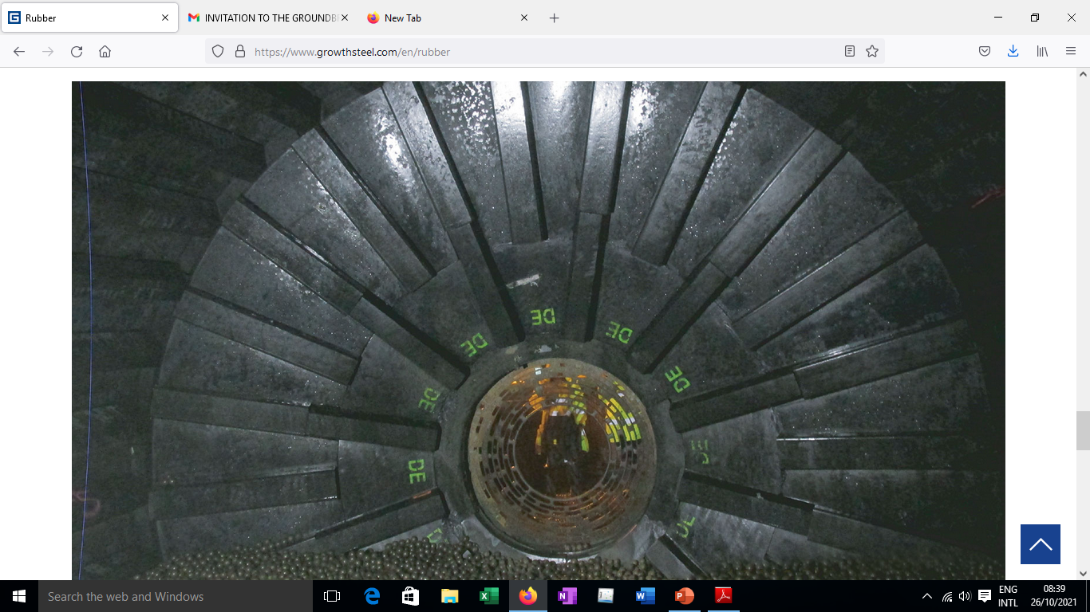
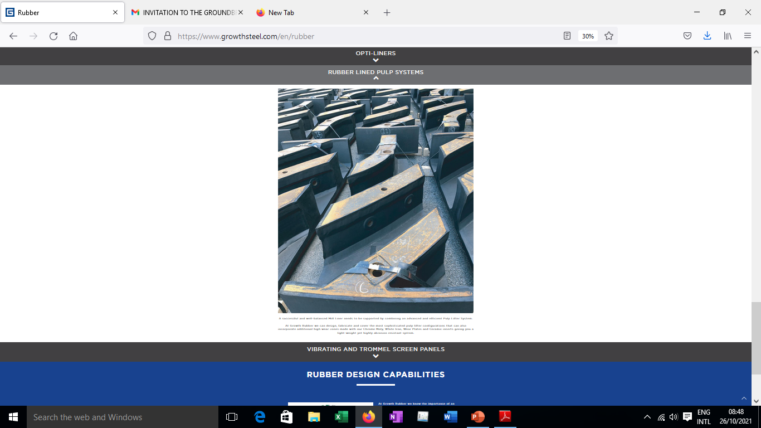
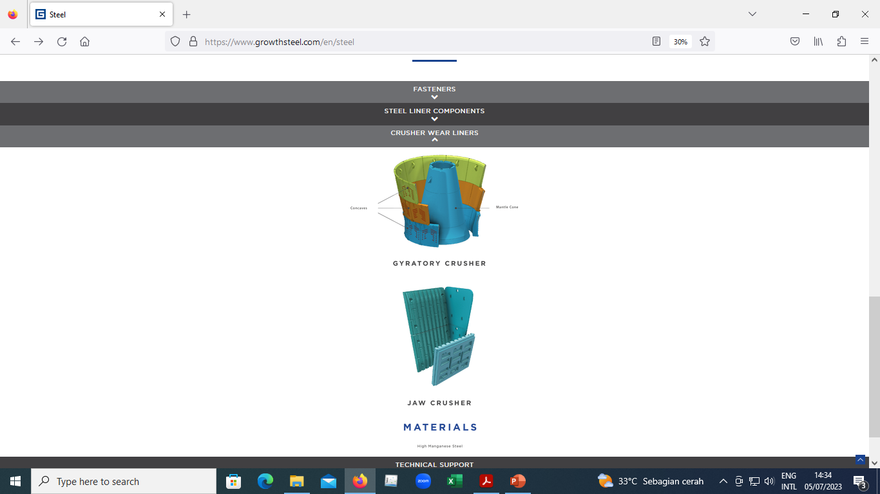
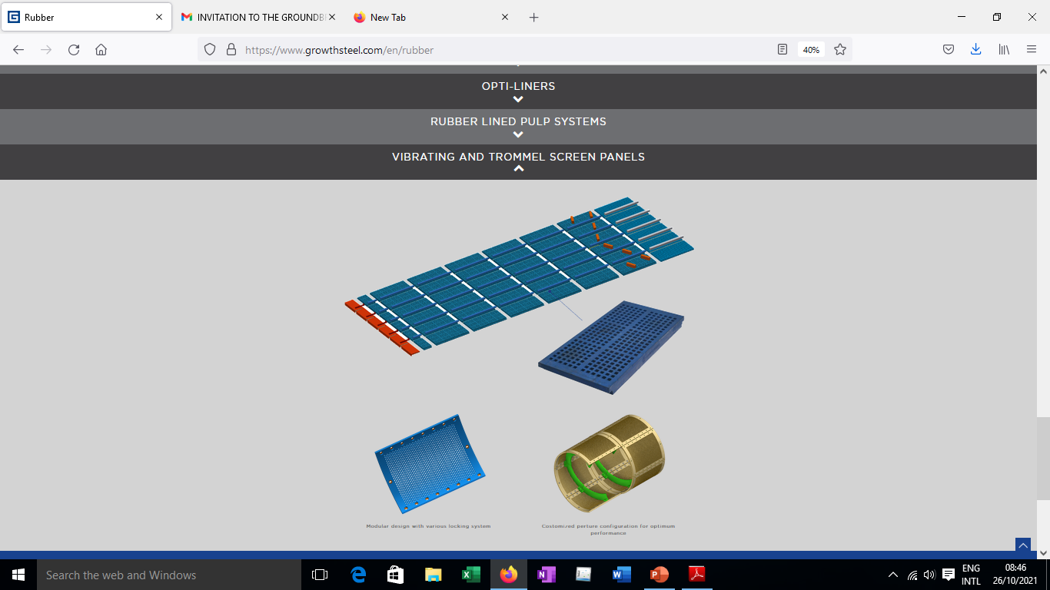
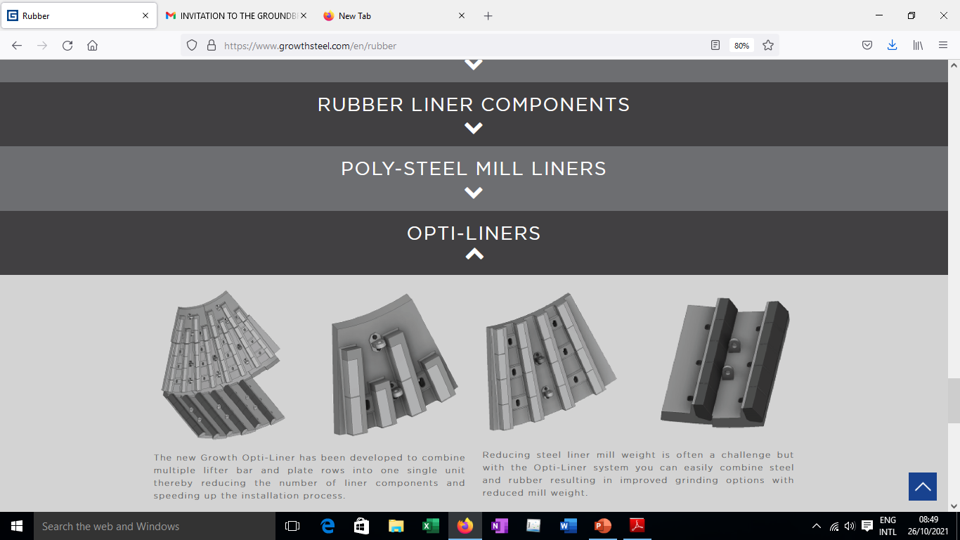
1.4. Aplikasi Casting di pertambangan & MIGAS
Steel Mill Liner
Crusher

Slide 8
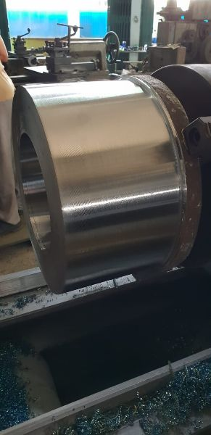
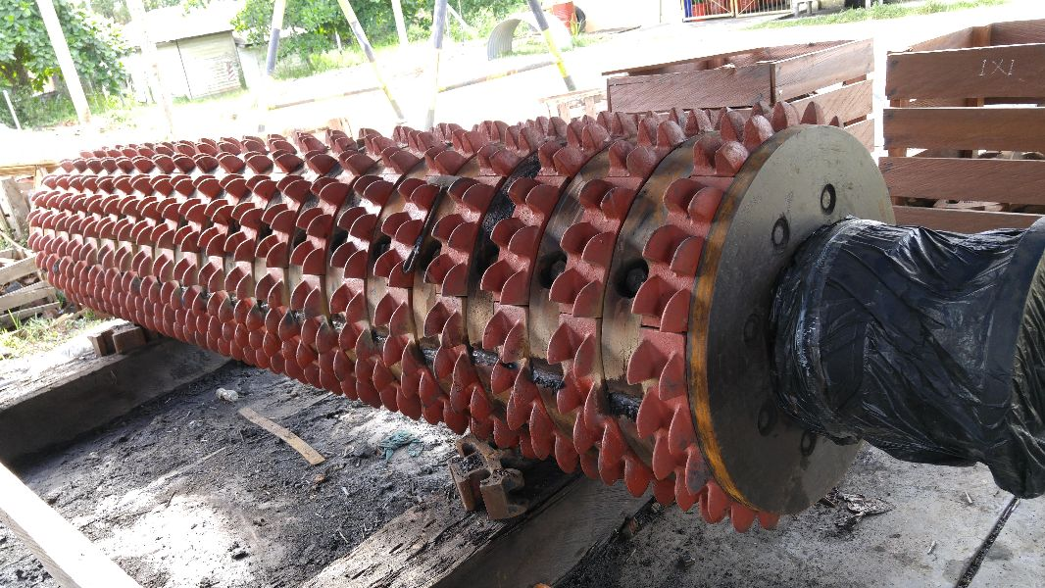
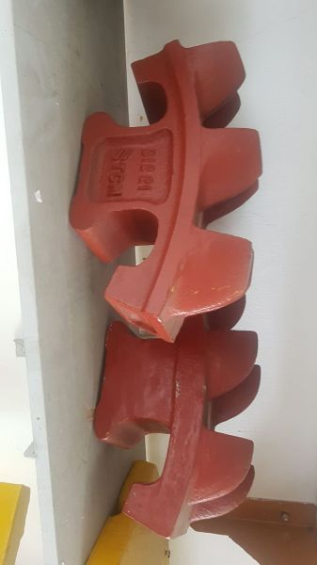
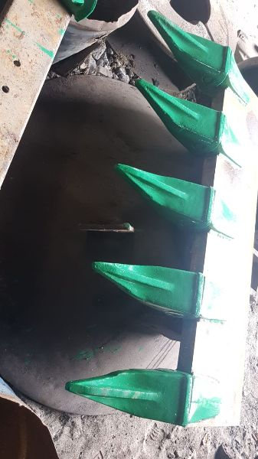
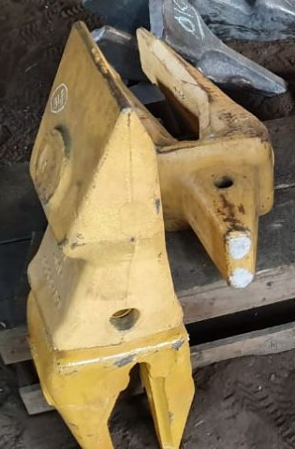
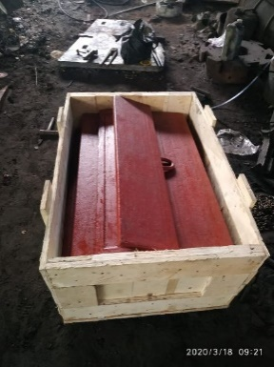
1.4. Aplikasi Casting di pertambangan & MIGAS

Slide 9
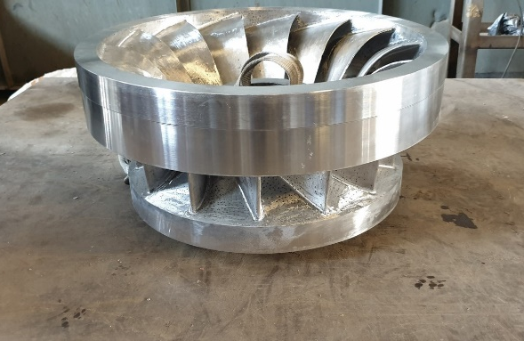
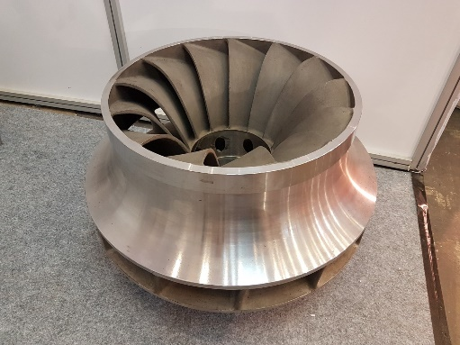
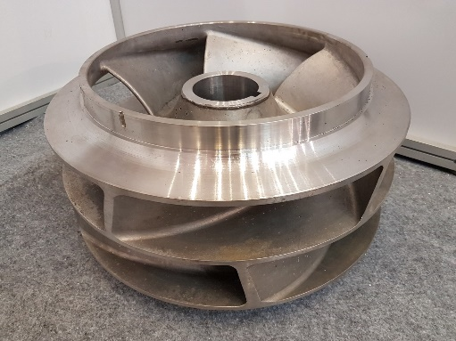
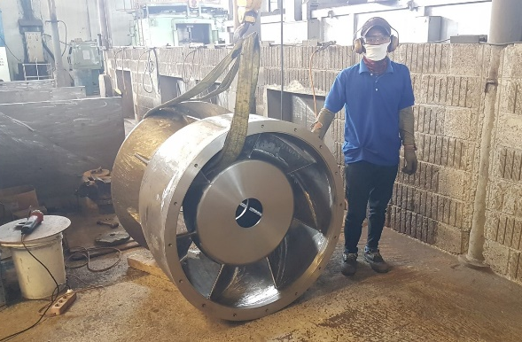
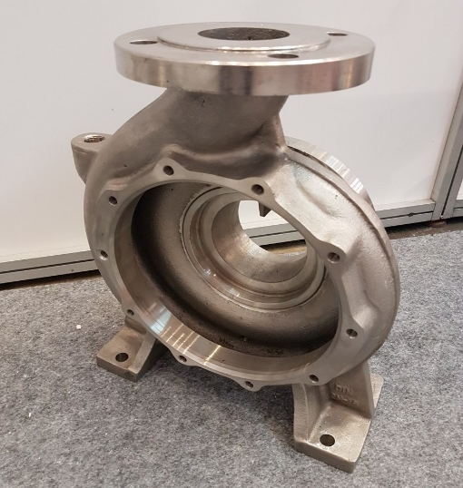
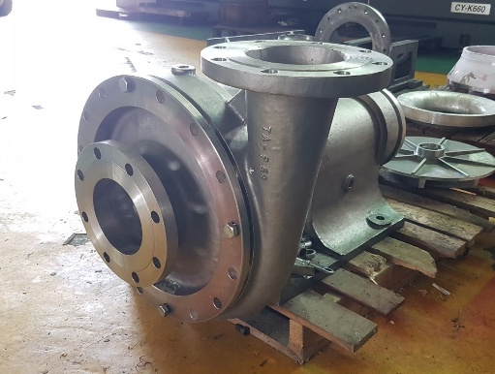
1.4 Aplikasi Casting di pertambangan & MIGAS
Impeller Hydro
Impeller Turbin
Impeller
Bowl Pompa Vertikal
Pompa Sentrifugal
Volute Casing Pompa

Slide 10




1.4. Aplikasi Casting di pertambangan & MIGAS

Slide 11
2. Preview Flow Proses Foundry
Contoh : Pengecoran Casting Ferro & indeks
★
Skrap, Fe-alloy, pig iron
★
Resin, dll
★
Welding wire, dll
※ Selain dari penyediaan fasilitas untuk produksi, industri Pengecoran Logam juga membutuhkan material-material pendukung yang penyediaannya seringkali terkendala karena masih Impor. Diperlukan studi kelayakan Hilirisasi untuk Material Pendukung tersebut.

Slide 12




2.1. General Process Pengecoran Logam
MELTING
MOLDING
FINISHING
HEAT TREATMENT
*Energi Listrik diperlukan untuk melebur raw material casting pada temperature tertentu.
*Energi Listrik diperlukan untuk menggerakkan mesin-mesin (mixer pasir, conveyor, crane, compressor).
*Umumnya digunakan pada proses welding, gouging & juga grinding yang bersumber dari Energi Listrik.
*Pemanasan produk pada suhu tertentu didapatkan dari sumber Energi Listrik atau Gas.
Energi Input | Listrik
Effect | Excess → Panas Waste → Dust, Slag
Energi Input | Listrik
Effect | Excess → - Waste → Dust, Sand
Energi Input | Listrik
Effect | Excess → Panas Waste → Dust, Sludge
Energi Input | Listrik, Gas
Effect | Excess → Panas Waste → Scale
setiap tahapan proses pengecoran logam membutuhkan energi, dan hal yang pasti Biaya energi tidak mungkin turun dan bagaimana kita menangani biaya tetap yang semakin meningkat secara permanen?
Semua perusahaan tentu telah memikirkan membuat produksi lebih hemat energi atau potensi penghematan yang dilakukan dengan mengoptimalkan apa yang sudah ada dengan biaya terbatas, namun upaya tersebut tidak mengarah pada solusi yang berkelanjutan (jangka pendek).
Dari proses pembuatan cetakan dihasilkan waste berupa sand foundry, proses finishing dihasilkan waste berupa Gram, dan juga terdapat waste dari supporting seperti general domestic waste (sisa makanan organik, kayu, kertas, kardus, wadah plastik) yang dimungkinkan dilakukan Pemanfaatan dan Pengolahan dengan konsep Green Factory pada Circullar Economy Circle.

Slide 13


3.1. World Wide Demand Forecast
A. Iron & Steel Casting Market
2021
2022
2023
2024
2025
2026
2020
2027
>$145.97 BN
CAGR (2021-27): 5.4%
>$210 BN
CAGR *(Compounded Annual Growth Rate) : the rate of return (RoR) that would be required for an investment to grow from its beginning balance to its ending balance, assuming the profits were reinvested at the end of each period of the investment’s life span.
1) CAGR by segment (‘21-’27)
2) Regional Outlook
1. Europe market share (2020) : >20%
5%
2. APAC market share (2020) : 60%
>5.5%
Ductile cast iron
Power & electrical segment
APAC (Asia Pacific) to dominates the industry size
Market Share
(‘20)
>$75BN
Sand casting
Source : www.gminsights.com

Slide 14


3.2. World Wide Demand Forecast
B. Application & Process
Automotive will be the leading application segment
Iron & Steel Casting Market Share (by Process), 2020, (USD Million)
Sand casting will be
the most preferred process
Source : www.gminsights.com

Slide 15
4.1. Challenge for Sustainability
A. Environment Issue
Process | Waste / Excess | Current Treatment | Future/Idea
Melting | Slag Melting Dust Hot | Construction Cement industry, pig iron No treatment | ← ← Boiler, preheat scrap
Molding | Sand Dust | Cement industry / construction | Silica dust, ceramic
Heat treatment | Scale Oil Hot | Pig iron Lubrication No treatment | ← Used Oil → Energy Boiler, oven preheat
Finishing | Metallic Dust | Pig iron | ←
B. Energy Utilization
Energy | Current source | Future/Idea
Electric | Coal, Diesel | Renewable Energy (Hydrogen, Solar panel, Wind energy, Biomas, Geothermal)
Gas | LNG/CNG, LPG
The Association encourages the industry to begin converting to more environmentally friendly energy sources.

Slide 16
4.2. Challenge for Sustainability
C. Process & Product Issue (include Technology)
Process | Current Condition / Issue | Future/Idea
Casting Design | Low Yield (Cap, Down Sprue, Runner, Riser) | Optimize casting simulation by direct pouring, filter, exothermic pad
Melting | Splash, impurity, excessive heat loss | Clean metal, advance refining, boiler, vacuum melting
Molding | High sand metal ratio, low reclamation ratio | Low sand metal ratio, V-process
Heat treatment | Conventional Process | Automation, simulation
Finishing | Repair/rework ratio, soundness, less accuracy control, manual handling | Upgrade technology casting design, Foundry 4.0, Automation
Inspection | Conventional method | Automation by digitalization method of inspection, image analysis
The Association supports the improvement of a better production process by involving industry experts and key persons to work together to improve competitiveness.

Slide 17
4.3. Challenge for Sustainability
D. People
Issue | Current Condition | Future/Idea
Lack of skill | Personal Training & OJT (On-Job Training) | Integrated by LSP (Professional Certification Agency) Next ???
Lack of employee’s availability | Link & Match program
E. Government Regulation and others
Issue | Current Condition | Future/Idea
Waste | Registered non-B3 (Hazardous and Toxic Materials) | Risk of Hazardous Material base on Ambang Batas (Threshold) → Collaboration with Government.
Energy | Mainly using energy from fossil | Will be use Renewable Energy, need special support from government
Material | Import Material | Localization ???
The Association encourages the industry together with the government to integrate people development programs through LSP (Professional Certification Agency)

Slide 18
5. APLINDO’s Concept of Sustainability
Promote application of registered
non-B3 (hazardous & toxic materials)
for slag, dust & foundry sand
Application energy price relaxation
(gas & electricity)
Regulation for import material
(scrap, raw material, etc)
Increase local content for government
project
Sustainability
of Industry
Environ ment & Energy
Process & Product
People
Govern ment Regulation
Usage of Renewable Energy
(hydro-power, solar, wind energy)
Application of carbon neutrality
(minimize CO2 emission, etc)
Application waste treatment
(water,slag, oil, dust etc)
APLINDO
(blue line) : APLINDO’s Role
APLINDO
Cooperation of domestic &
international associations
(KTEC-Korea, AFA-Asia)
Collaboration University &
Vocational education (Link & Match)
Promote integrated people
development through LSP
Upgrade technology of casting
design (yield, SM ratio) by casting
simulation (Magma, Z-Cast, etc)
Less rework of manual operation
(grind, weld) by Automation
Digitalization for Foundry 4.0
※ APLINDO plays an important role in bridging industry needs with stakeholders, including government policies to achieve goals in all aspect SQDC (Safety-Quality-Delivery-Cost).

Slide 19
6. Conclusion
“APLINDO & all stakeholders are always trying to improve their competence & contribution to increase competitiveness, so that the industry always growth & sustain.”

Slide 20
Thank You
Sekretariat :
Komp.Perkantoran Graha Kencana Blok GK Lantai 6C
Jl. Raya Pejuangan No.66 Kebon Jeruk Jakarta Barat
Telp.021.5359050 email : aplindo71@gmail.com

