Slide 1
ESG Investing, Sustainable Finance, and Climate Transition
Hakimul Batih
Board member of Indonesian Institute for Energy Economics (IIEE)
Presented at Technology Talk Series: Sustainability in Mining and Mineral Processing Through Technology

Slide 2
The Future of ESG Investing
ESG assets will hit $50 trillion by 2025 from about $35 trillion now, representing more than a third of the projected $140.5 trillion in total global assets under management, according to Bloomberg. They have grown from $30.7 trillion in 2018 and $22.8 trillion in 2016
Global business leaders across all industries anticipate strong growth in ESG assets, and they are making investments in ESG with the same bottom line-driven focus as their non-ESG investments. A resounding 71% of global business leaders believe that, “Eventually, no investment decisions will be made without considering ESG.”
https://sponsored.bloomberg.com/article/mubadala/the-future-of-esg-Investing

Slide 3
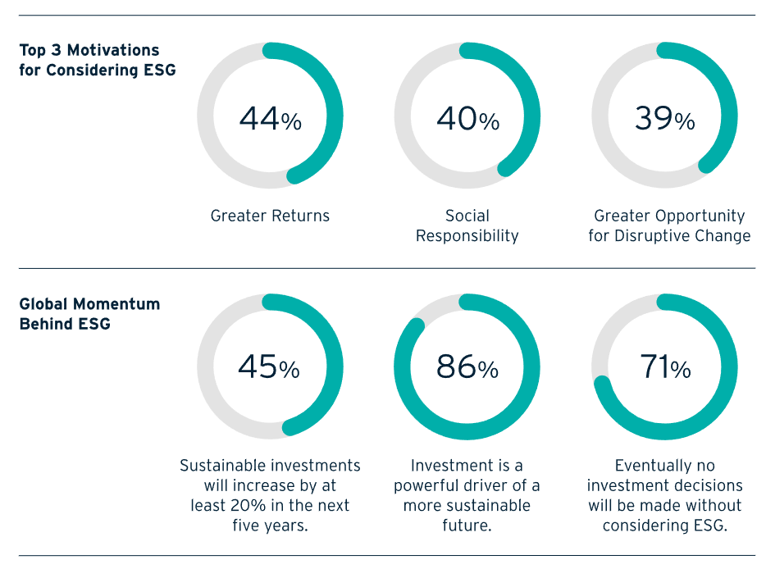
ESG Motivation
https://sponsored.bloomberg.com/article/mubadala/the-future-of-esg-Investing

Slide 4
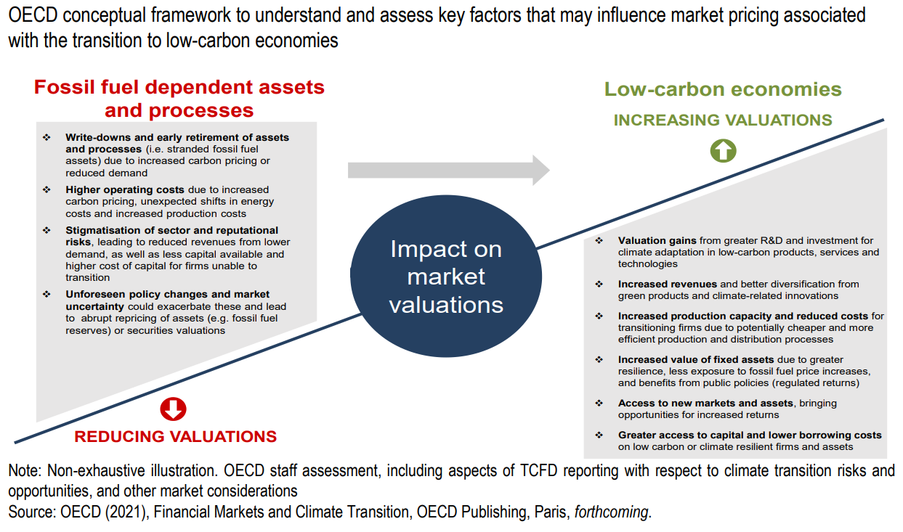
Key factors influencing market pricing associated with the transition to low carbon economy

Slide 5
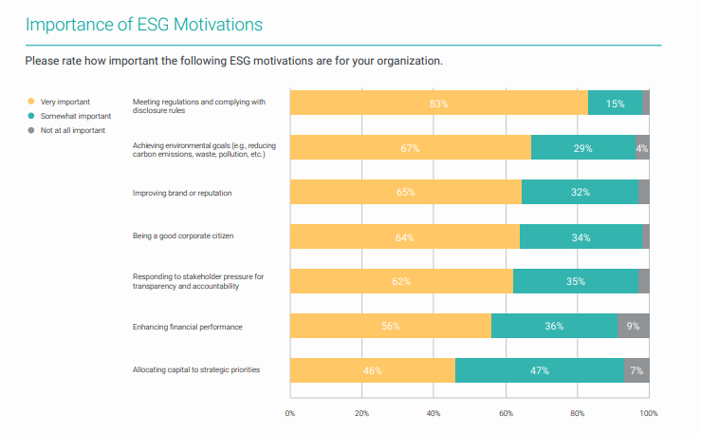
ESG Motivation
Source: The Morningstar Sustainalytics Corporate ESG Survey Report 2022

Slide 6
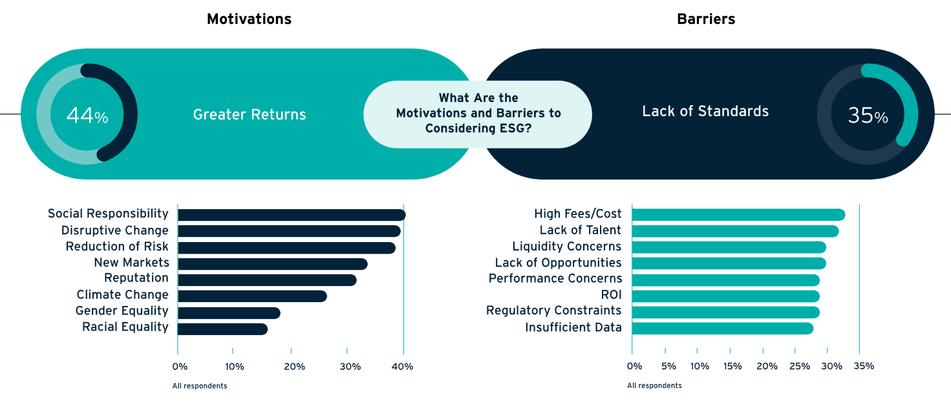
Motivation and Barriers
While the study finds great enthusiasm for ESG investments, the lack of defined standards to assess performance is a barrier to investment in this sector.
https://sponsored.bloomberg.com/article/mubadala/the-future-of-esg-Investing

Slide 7
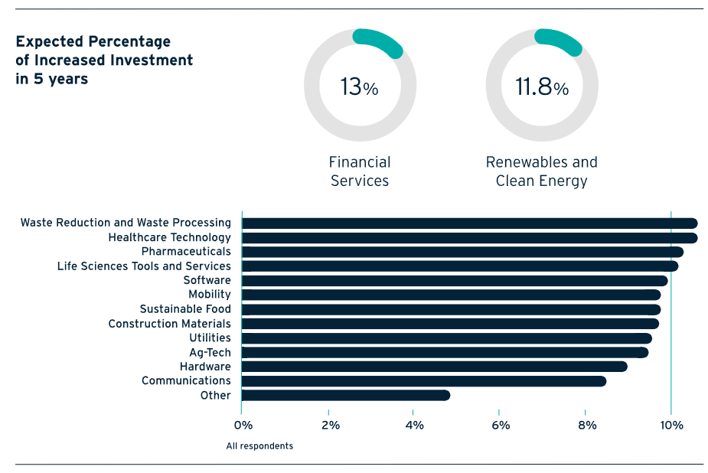
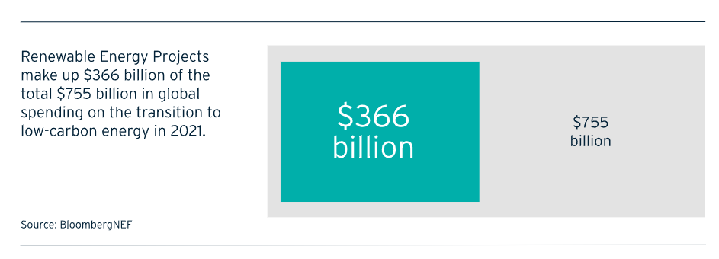
Industry leading the world in ESG
When we break down ESG and evaluate which element contributes most to shareholder value, Environmental carries the bulk of the weight today, and Renewables and Clean Energy receives the highest portfolio allocations
BloombergNEF estimates that $2.1 trillion of investment is needed in the energy transition from 2022-25, nearly three times last year’s level. In addition to renewable energy projects, this figure includes electrified heat, energy storage and nuclear power.
https://sponsored.bloomberg.com/article/mubadala/the-future-of-esg-Investing

Slide 8
Definisi dan Tujuan Keuangan berkelanjutan
Keuangan Berkelanjutan adalah dukungan menyeluruh dari sektor jasa keuangan untuk menciptakan pertumbuhan ekonomi berkelanjutan dengan menyelaraskan kepentingan ekonomi, sosial, dan lingkungan hidup. Produk dan/atau Jasa Keuangan Berkelanjutan adalah produk dan/atau jasa keuangan yang mengintegrasikan aspek ekonomi, sosial, dan lingkungan hidup, serta tata kelola dalam fitur-fiturnya (ESG). (POJK No. 51/POJK.03/2017 tentang Penerapan Keuangan Berkelanjutan bagi Lembaga Jasa Keuangan, Emiten, dan Perusahaan Publik)
Keuangan Berkelanjutan adalah sebuah ekosistem dengan dukungan menyeluruh berupa kebijakan, regulasi, norma, standar, produk transaksi, dan jasa keuangan yang menyelaraskan kepentingan ekonomi, lingkungan hidup, dan sosial dalam pembiayaan kegiatan berkelanjutan dan pembiayaan transisi menuju pertumbuhan ekonomi yang berkelanjutan. (UU No. 4 Tahun 2023 tentang Pengembangan Penguatan Sektor Keuangan)
Source: OJK

Slide 9
Mengapa Sustainable Finance Penting?
New Business Paradigm
Telah terjadi proses perubahan pandangan menuju sistem keuangan yang lebih ramah lingkungan. Oleh karena itu, diperlukan percepatan perubahan pola pikir dari kegiatan usaha Business as Usual menjadi kegiatan usaha yang lebih ramah lingkungan.
New Business Opportunities
Adanya peningkatan jumlah investor hijau, sehingga mempercepat transisi Sustainable Finance menjadi platform transisi aktivitas ekonomi.
New Risk Management
Mulai diperhitungkannya climate-related financial risk dalam setiap pembiayaan/investasi, sehingga tercapainya pertumbuhan yang lebih berkelanjutan.
Source: OJK

Slide 10
Tantangan keuangan berkelanjutan
Supply
Sektor Keuangan di Indonesia relatif masih dangkal
Pembiayaan untuk sektor yang dinilai hijau pada umumnya masih berjangka pendek
Terbatasnya tenaga ahli di sektor keuangan yang memahami proyek hijau
Masih kurangnya pemahaman dari sektor keuangan terhadap proyek hijau (misalnya ketersediaan skema pembiayaan yang sesuai, kerangka manajemen risiko, dan lain sebagainya)
Demand
Besarnya investasi dan biaya operasional yang diperlukan untuk proyek hijau bila dibandingkan dengan proyek konvensional.
Margin keuntungan pada proyek hijau yang dinilai masih kurang menarik bila dibandingkan proyek konvensional.
Tingginya risiko kegagalan proyek karena menggunakan teknologi baru, serta terbatasnya teknologi baru yang tersedia.
Terbatasnya teknologi dan tenaga ahli.
Source: OJK

Slide 11
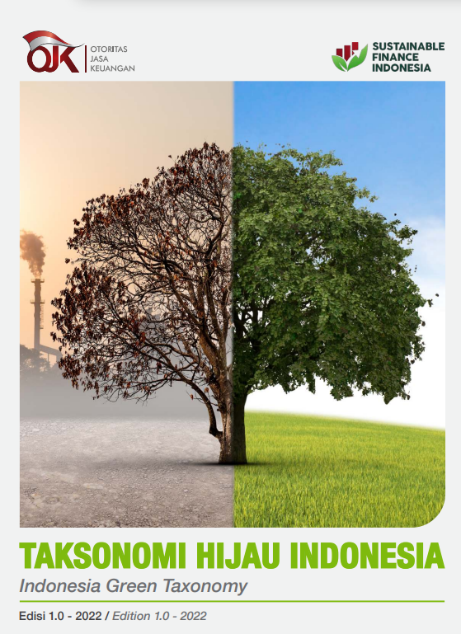
Taksonomi Hijau Indonesia Edisi 1.0
Taksonomi hijau: Klasifikasi aktivitas ekonomi yang mendukung upaya perlindungan dan pengelolaan lingkungan hidup serta mitigasi dan adaptasi perubahan iklim
Manfaat:
Sebagai panduan untuk mengalokasikan modal, alat untuk mendukung penilaian risiko, dan referensi bagi pemangku kepentingan lainnya dalam mendukung implementasi kepada upaya mitigasi dan adaptasi perubahan iklim.
Mendorong pembiayaan berkelanjutan untuk mendukung pencapaian target NDC (termasuk proyek-proyek energi terbarukan).
Dalam pengembangannya taksonomi hijau bersifat fleksibel dan dinamis sehingga dapat beradaptasi dengan strategi dan pola investasi serta menyesuaikan perubahan teknologi, ilmu pengetahuan, aktivitas dan data baruptasi terhadap perubahan iklim.
Source: OJK

Slide 12
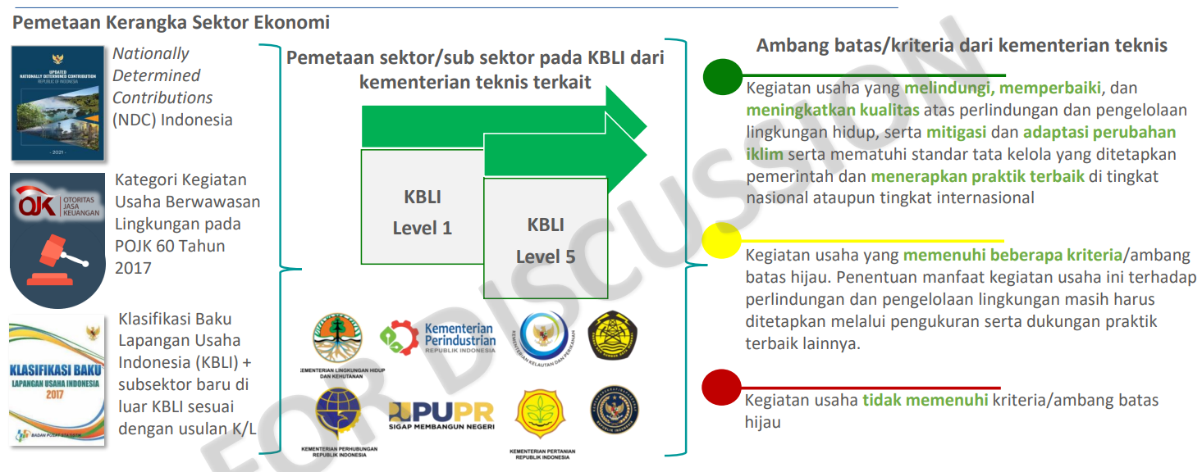
Taksonomi Hijau Indonesia Edisi 1.0
Framework
Source: OJK

Slide 13
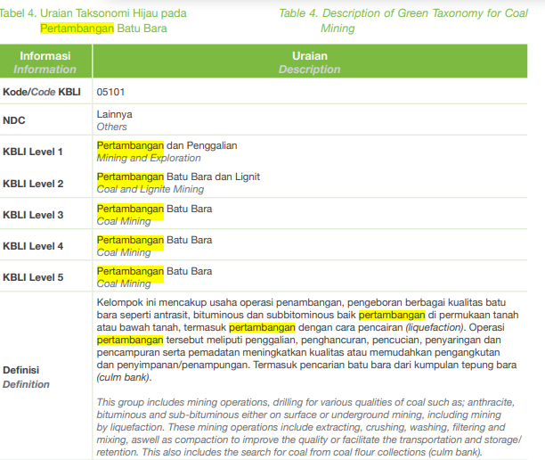
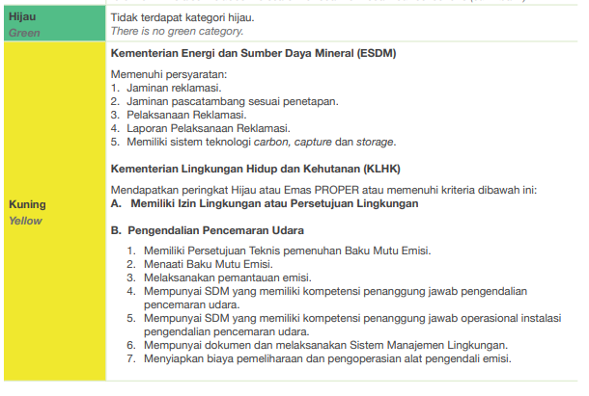

Slide 14
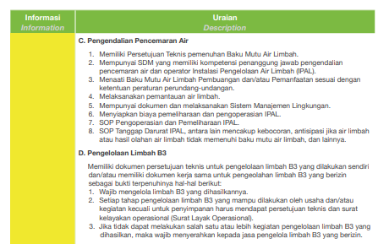
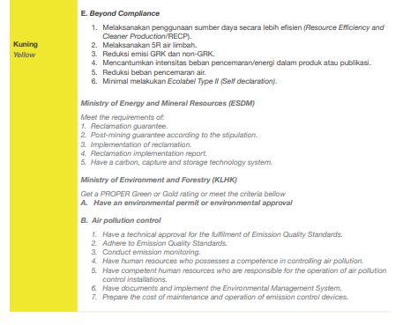

Slide 15
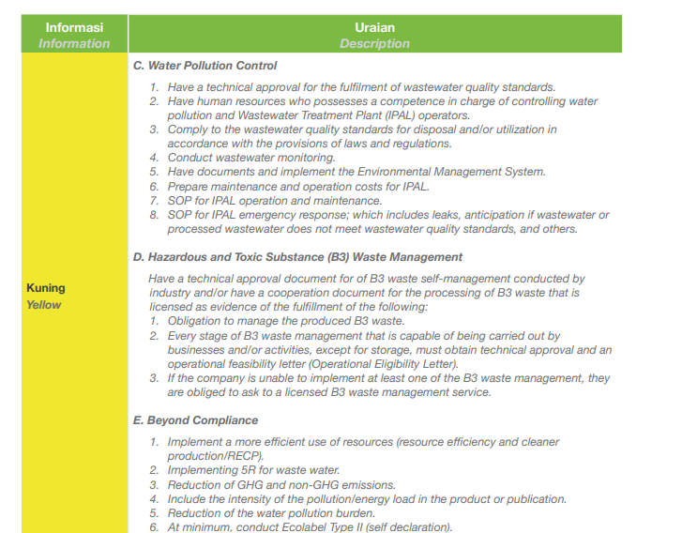
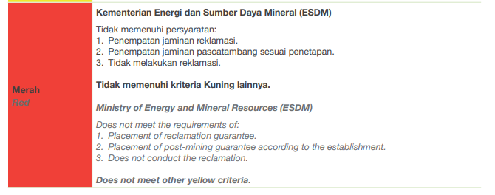

Slide 16
Pengkinian Taksonomi Hijau
Latar belakang pengkinian: Kepentingan Nasional
THI harus selaras dengan kepentingan nasional serta Sustainable Development Goals (SDGs 2030) yang mengintegrasikan aspek ekonomi, sosial, dan lingkungan.
THI agar selaras dengan berbagai inisiatif pemerintah, termasuk Energy Transition Mechanism (ETM), Just Energy Transition Partnership (JETP), dan bursa karbon.
Indonesia saat ini fokus pada coal phasing out program. Taksonomi diharapkan dapat mendukung inisiatif pemerintah terkait transition finance.
Mendukung program hilirisasi pemerintah
Taksonomi akan memiliki tujuan lingkungan dan kriteria esensial lainnya (Do No Significant Harm, Remedial Measures to Transition, dan Social Aspects).
Penyesuaian dari semula “Taksonomi Hijau” menjadi “Taksonomi Berkelanjutan”.

Slide 17
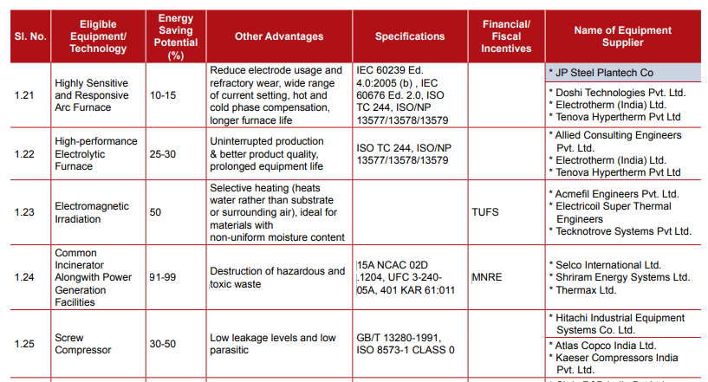
List of Efficient Technologies for Financing
Development of energy efficient technology list for financing covering description of technology, potential saving, sector of implementation, annual monetary saving, payback period, capacity, etc., would increase the confidence of financial institution to finance the projects.
Source: JICA - SIDBI MSME Energy Saving Project (Phase - III)
Source: Bureau of Energy Efficiency, Government of India

Slide 18
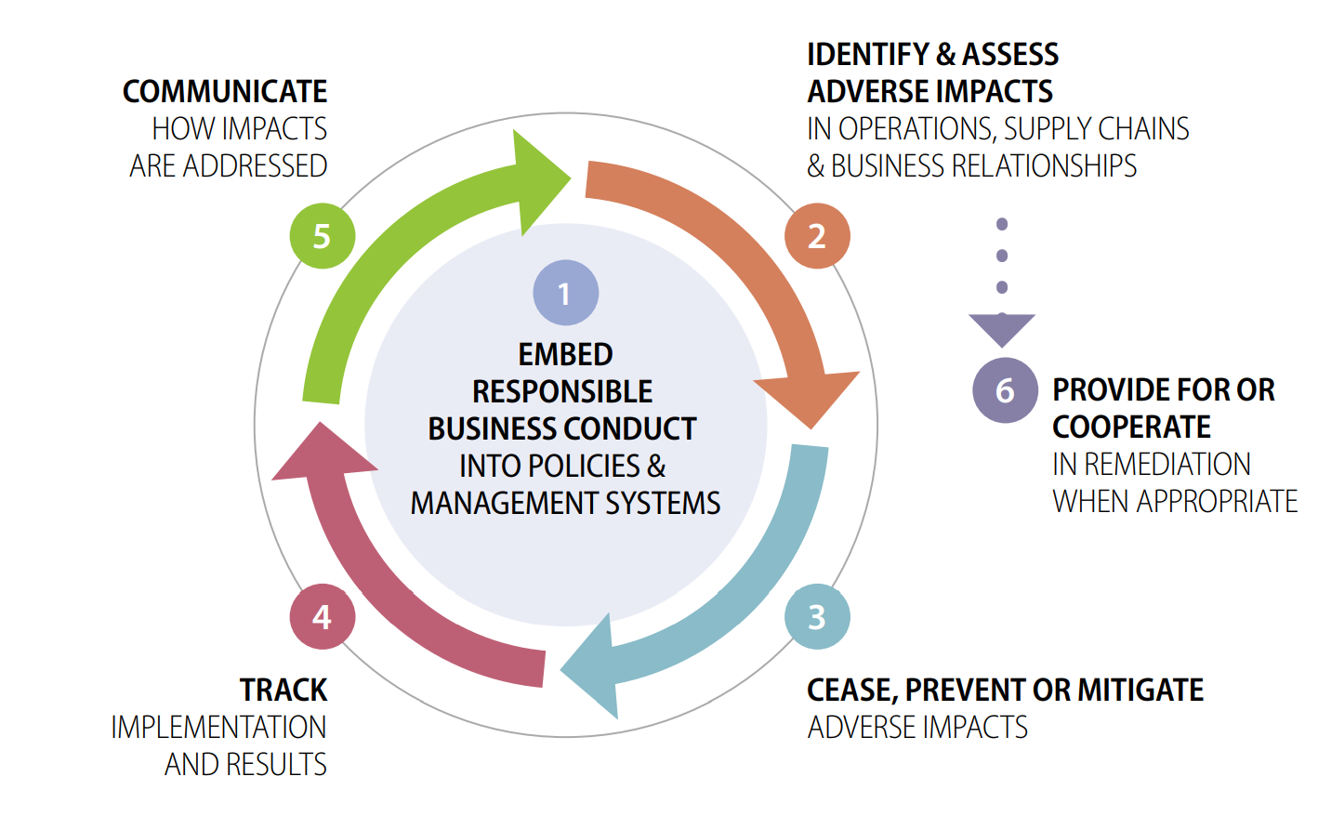
RBC due diligence as a tool to address adverse impacts of the transition
Responsible business conduct (RBC) is a policy concept that sets out an expectation that all businesses address negative impacts of their operations, while contributing to sustainable development in the countries where they operate.
RBC is operationalized in practice by business through “RBC due diligence”, which provide a framework on how to identify, prevent and mitigate adverse impacts on people and planet
The transition to low-carbon economy will generate new risks that RBC can help prevent, address or minimize
Transitioning-in risks: risks increasing from high-demand for new materials, products and services necessary for the transition (i.e., minerals)
Transitioning-out risks: risks increasing from phasing out of specific high-emitting products, assets, projects and sectors (i.e., fossil fuel)
Distributional impacts & global equity: addressing the unintended consequences of the race to zero on development objectives
Source: OECD
Notes:
Note that there has been growing recognition that the environmental crisis, and in particular climate change, has adverse impacts on the fulfilment and realization of internationally recognized human rights
Note that similarly, transitioning from a carbon intensive economy and delivering net-zero commitments is likely to generate major disruptions through economic restructuring, workforce displacement, financial flaw reallocations, job losses and creations or localized disruption in the availability and price of goods and services.
In that context, businesses and investors will be expected to address such adverse impacts resulting from their rapidly evolving business and operating models, including in their supply chains
Note that the OECD Responsible Business Conduct framework can prove useful to equip businesses in addressing such risks – that OECD RBC principles and standards has been recognised as authoritative instruments on how to interpret corporate’s role in enabling a just transition. – both in laws (i.e. taxonomy) and in court decisions.
More specifically, a rapid transition is likely to generate specific categories of risk and impact that RBC due diligence can help identify, prevent and mitigate: both the risks of the transition-out of carbon intensive industries and economic activities – and the transition-in to low-carbon sectors and resources while also taking into consideration the distributional impacts of climate change, particularly on those who are most vulnerable to climate impacts – at both project-level and in terms of global equity
By carrying out risk-based due diligence, companies can responsibly engage in higher-risk sectors, geographies and supply chains and avoid blanket divestment strategies that can impede the development paths of emerging countries.
For example, note that the OECD Centre for RBC is also currently working – through Sustainable Infrastructure in Asia Programme (SIPA) in developing policy insights and workshops for businesses on how to ensure sustainable infrastructure development through an RBC lens.

Slide 19
Thank you

